Slide 1
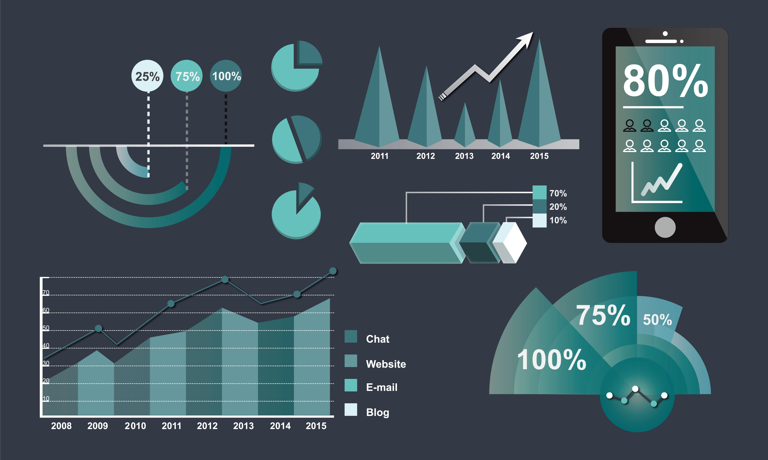
Accredian Telecom Data Analysis EDA Project form Accredianians
1010 Group
Akanksha Kaushik
Annu
Harsh Saurav
Preeti
Sai Brahamaiah
Naveen

Slide 2

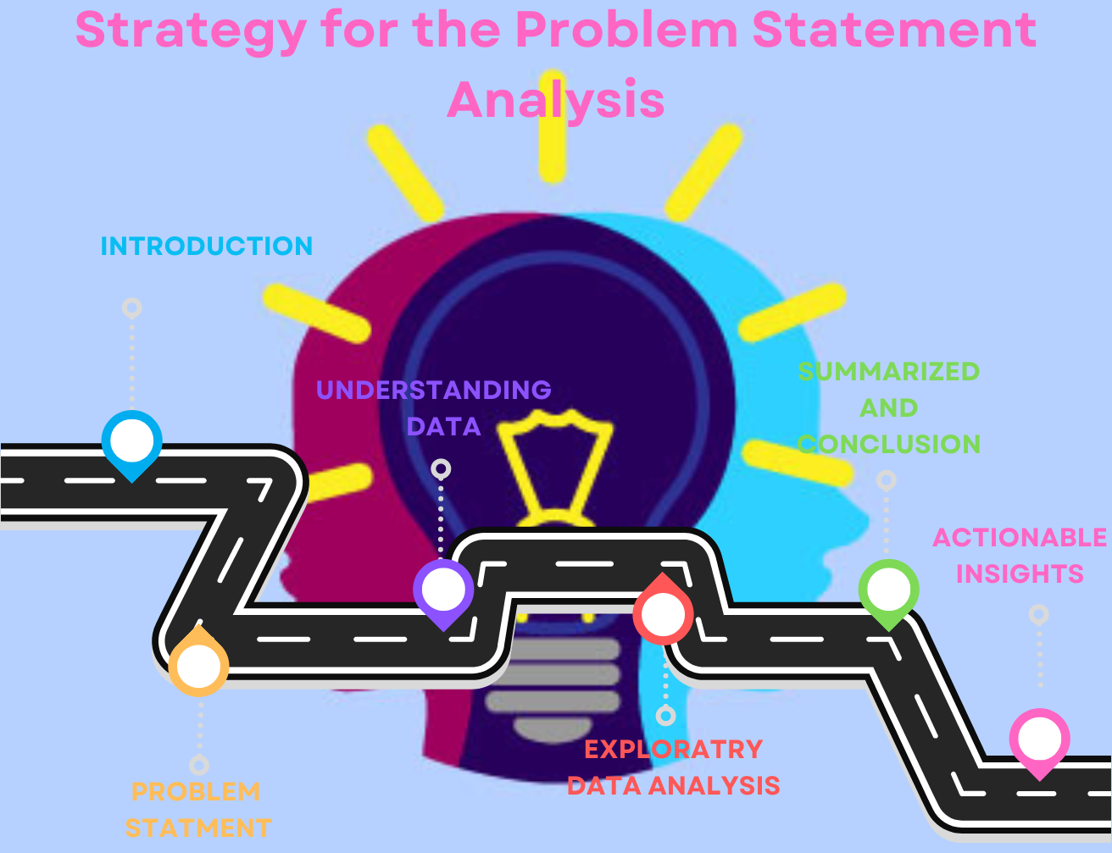

Slide 3
INTRODUCTION
AccredianTelecom, one of the prominent telecom players
Empower Your Connections with AccredianTelecom: Elevating Your Telecom Experience
Looking to redefine the way you connect with your loved ones and the world around you? Look no further than AccredianTelecom, your ultimate destination for cutting-edge telecom networking services. As a frontrunner in the telecom industry, we are dedicated to enhancing your communication experience and taking it to unprecedented heights.

Slide 4
Problem Statement
AccredianTelecom, one of the leading telecom players, understands that customising offerings is significant for its business to stay competitive.
This company approaches Accredianians, and asks them to come up with a dashboard that will help us to understand a user's demographic characteristics based on their mobile usage, geolocation, and mobile device properties

Slide 5
UNDERSTANDING OF DATA

Slide 6
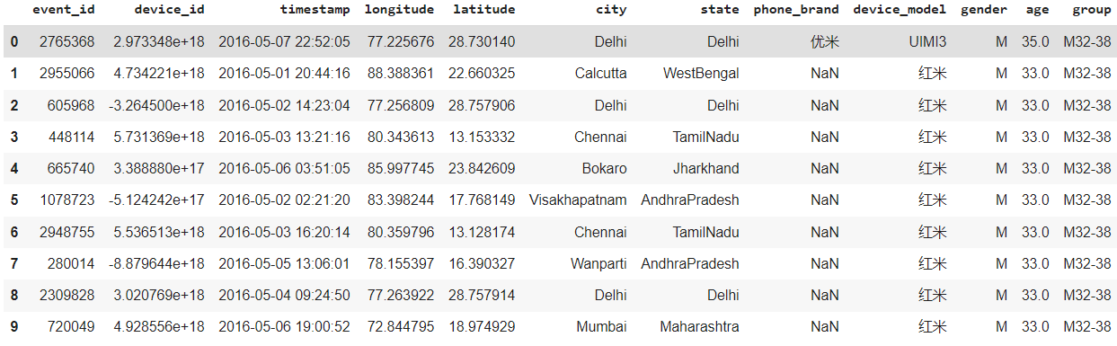
THE SAMPLE OF THE DATASET

Slide 7
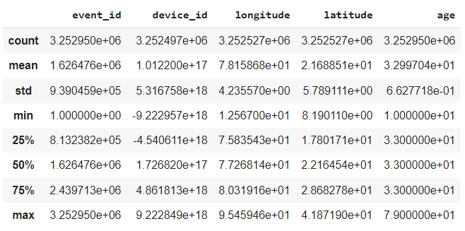
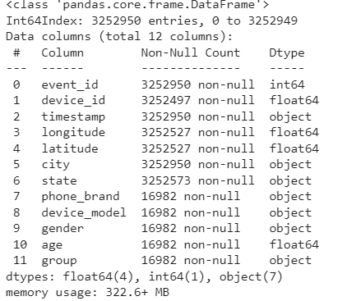
THE STATISTICS OF THE DATASET

Slide 8
EXPLORATORY DATA ANALYSIS

Slide 9
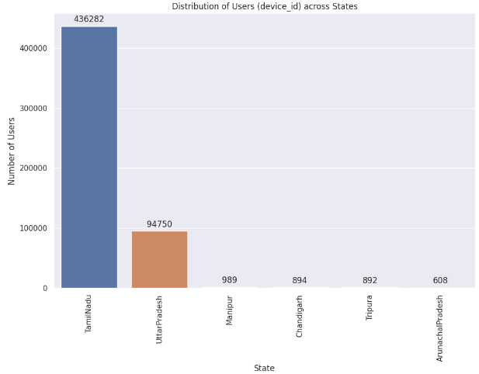
Observation -According to the above graph, it has been observed that Tamil Nadu (Chennai) has the highest number i.e 436282 of users across other states (UP, Manipur, Chandigarh, Tripura, Arunachal Pradesh)

Slide 10
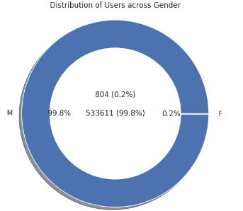
Observation -The above donut graph shows the distribution of users across gender. This graph reveals that the maximum number of users are males with a percentage of 99.8% in comparison to female users who are 0.2%.

Slide 11
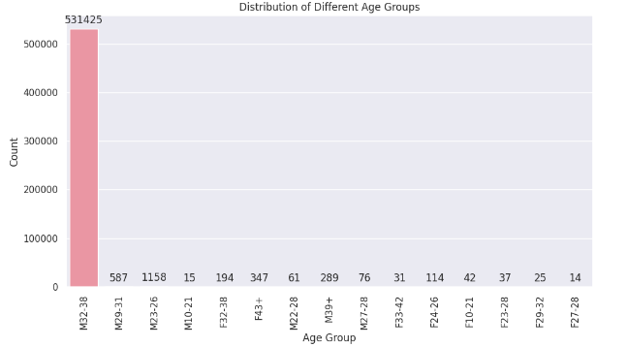
Observation -: We have observed from the graph that the age group which is having a maximum count is M 32-38. I mean that male users within the age group of 32-38 are the maximum in number. There is very less number of female users apart from that most belong to the 43+ age group.

Slide 12
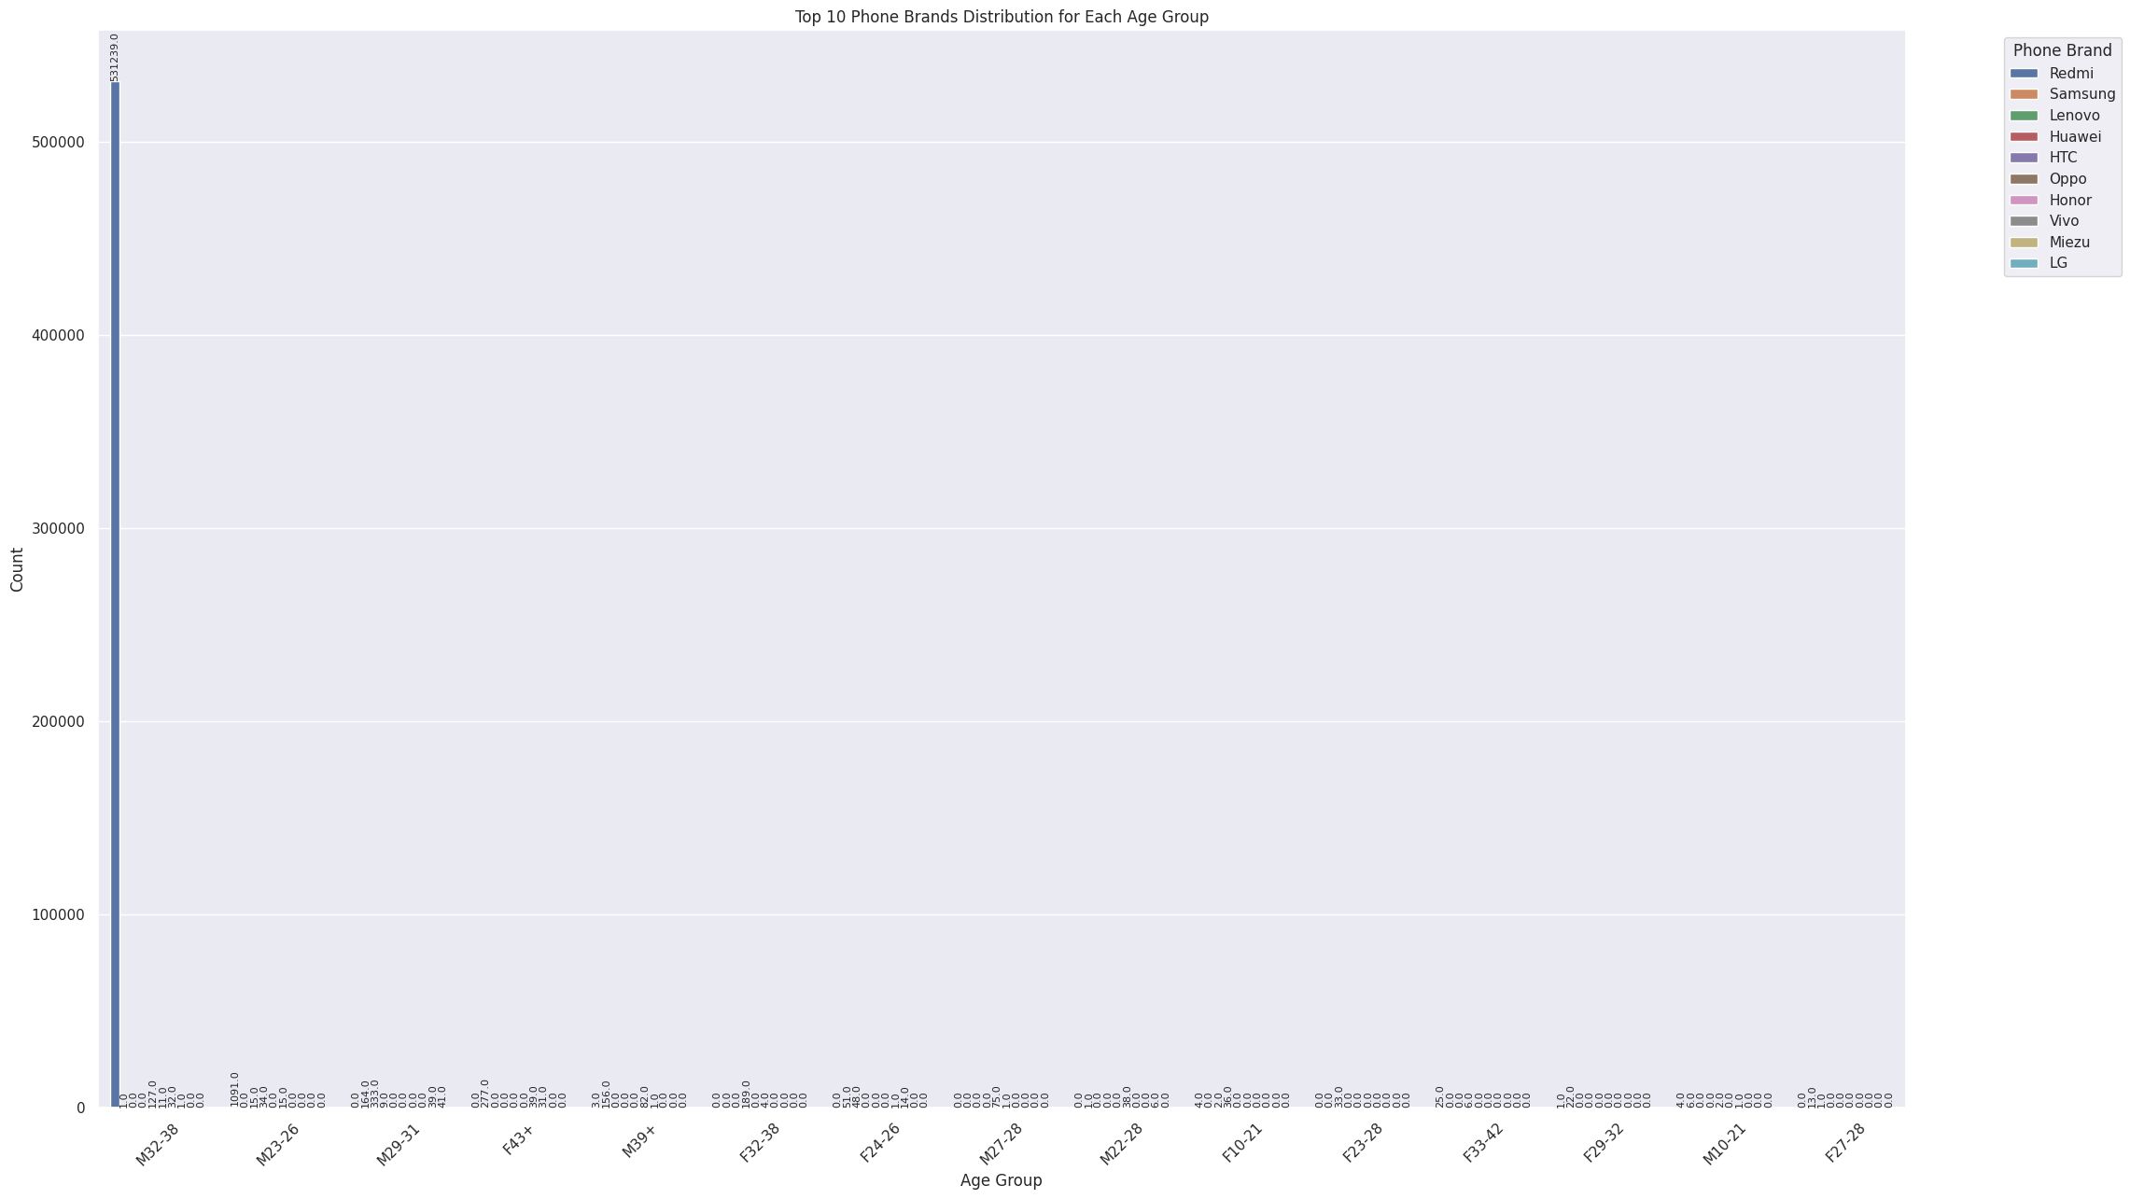
Observation:- On looking at the bar, it can be easily predicted that the most liked brand is Redmi amongst the males of age between 32 and 38.

Slide 13
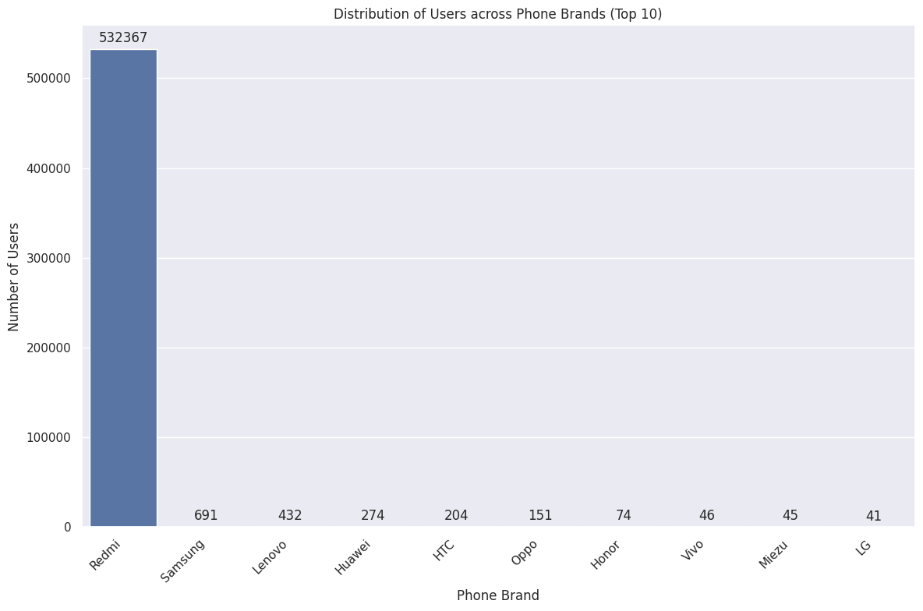
Observation- It has been observed that amongst the top 10 phone brands, Redmi is leading the market, i.e.Redmi is dominating with above 5 million users.

Slide 14
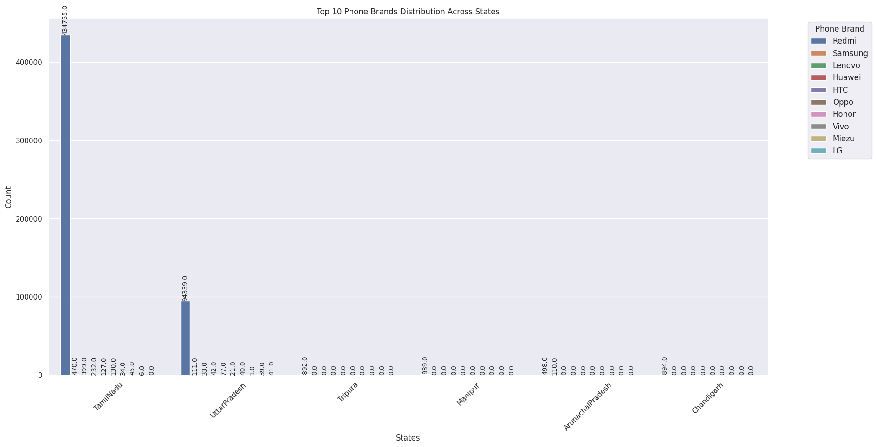
Observation:-The above graph suggests that across all the cities, Tamil Nadu has secured the highest rank in the number of users and 2nd highest is achieved by Uttar Pradesh

Slide 15
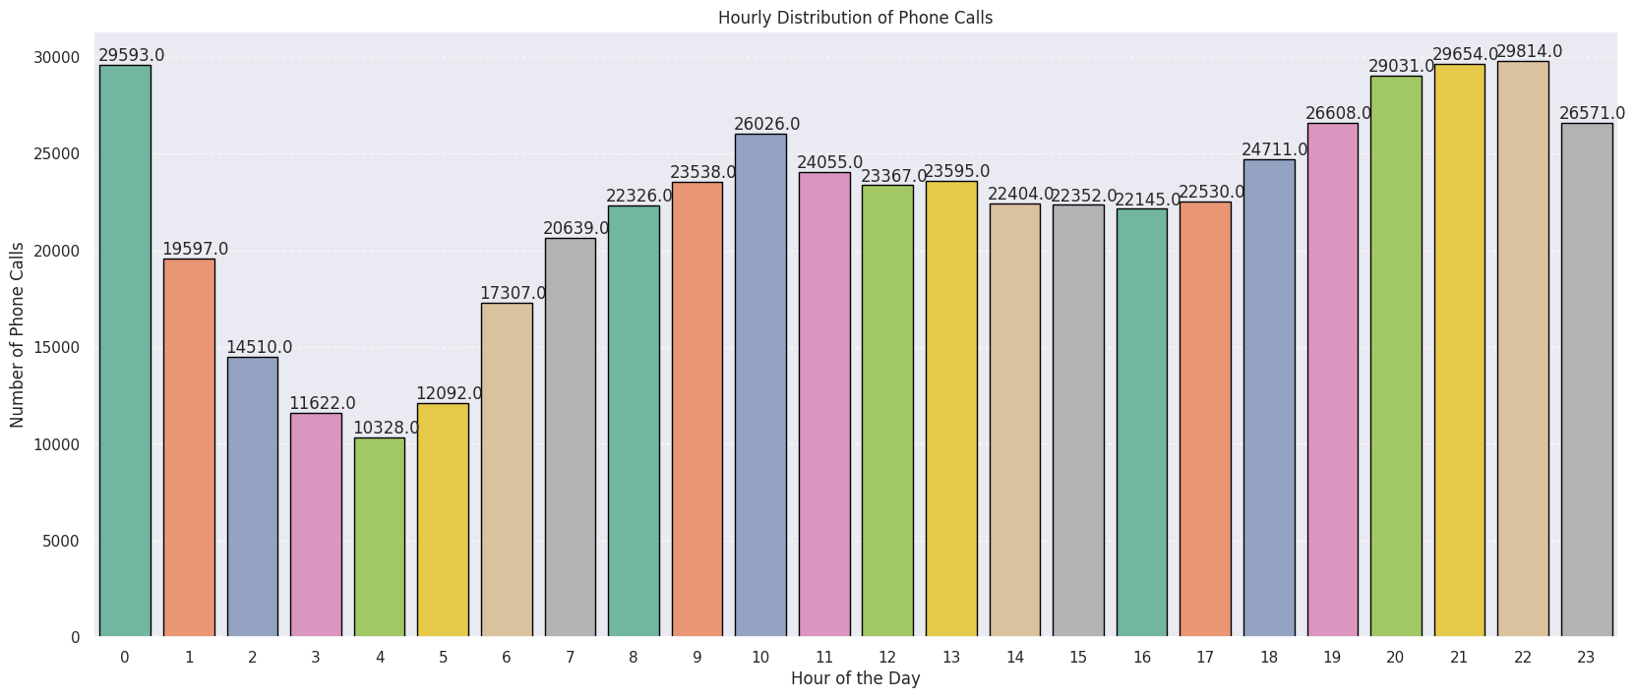
The Hourly distribution of phone calls is shown in the above graph. It has certain observations:
The calls are done mostly at night, i.e. from 8 PM to 12 AM
The least number of calls are made during the early morning time, i.e. 3 AM to 5 AM
There is a little bump in the number of calls made in the morning, i.e. 10 AM.

Slide 16
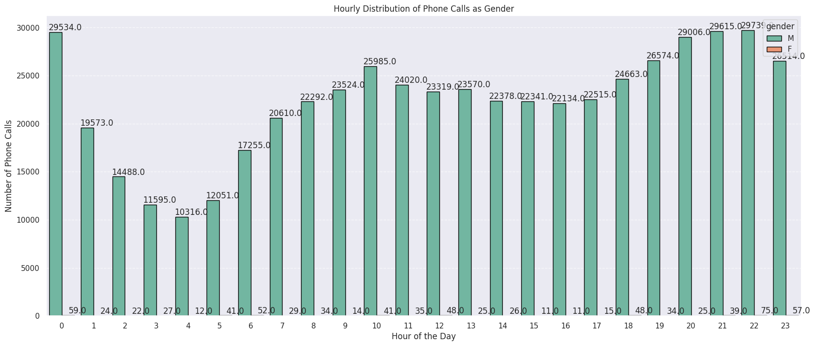
Observation:-The Hourly distribution of phone calls amongst the male and female users is shown in the above graph. This graph suggests that the maximum number of phone calls are made by users in the time duration of 8 PM to 12 AM and the least number of calls are made in the early morning hours i.e. 3 AM to 5 AM. Whereas the least number of calls are made by female users.

Slide 17
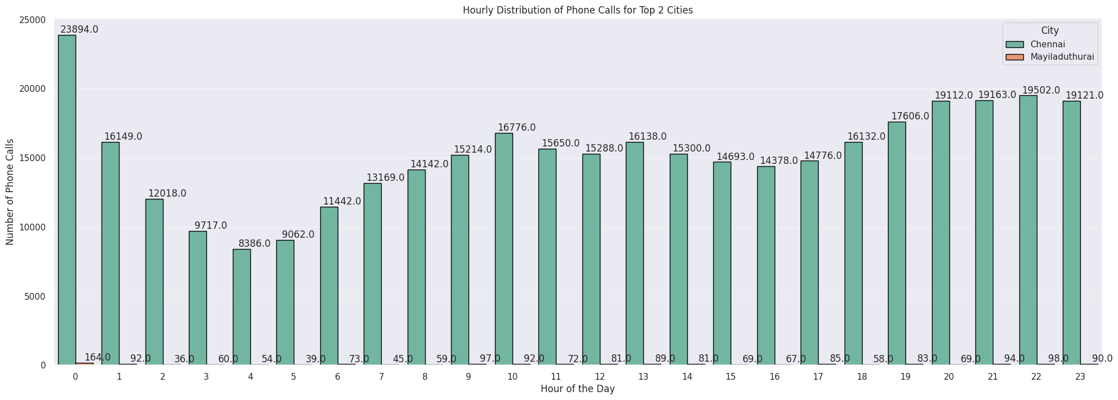
Observation:- The Hourly distribution of phone calls amongst the top two cities shows that Chennai has the highest number of phone calls made throughout the day, whereas the 2nd number is achieved by Mayiladuthurai.

Slide 18
Geospatial Analysis

Slide 19
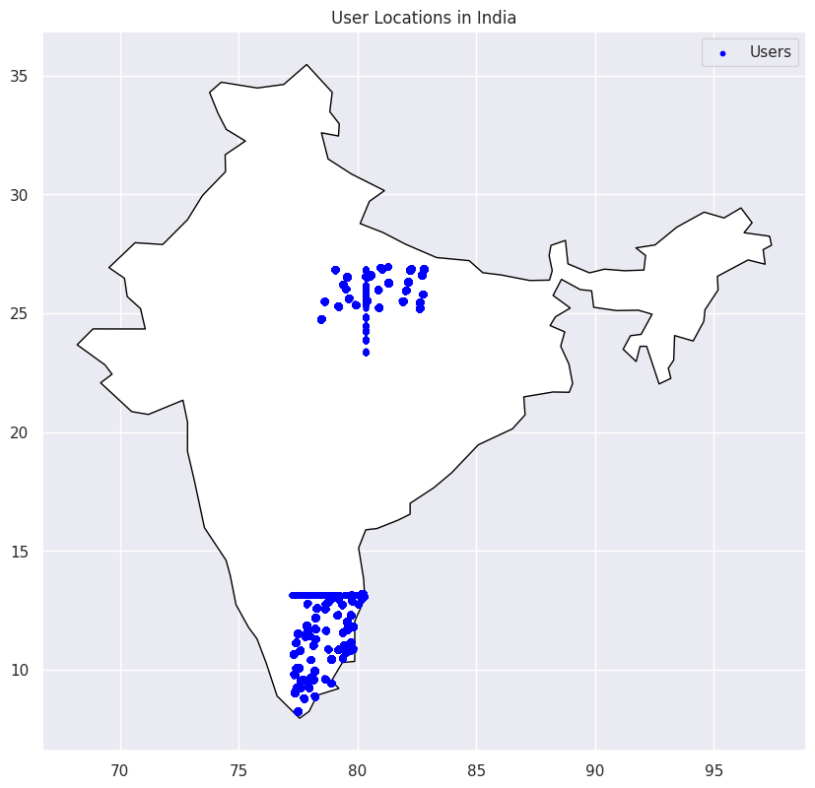
Geospatial Analysis: Mapping user data FOR geospatial analysis.
Andhra Pradesh state in India, has a significant number of users.

Slide 20
SUMMARIZED CONCLUSION
Unravelling User Composition: The Gender Mosaic
- 99.8% Male Users, 0.2% Female Users - Unveiling the Majority!
- Dominance of Male Users - Fueling the Conversational Landscape.
Geographical Gems: Tamil Nadu & Uttar Pradesh Shine
- Tamil Nadu & Uttar Pradesh Take the Spotlight - A Haven for User Engagement!
- The Heartbeat of India's Conversations - Witness the Vibrancy.
Brand Royalty: Redmi, Samsung & Lenovo Lead the Way
- Redmi, Samsung, Lenovo - The Triumvirate of Trendsetting.
- Redmi's Meteoric Rise - A Journey to Fame and Favor!
Age Chronicles: Pioneers of the 32-38 Era
- Ages 32 to 38 - Where the Magic Unfolds.
- Male Marvels in M32-38, Female Champions in F33-43+ - A Power-Packed Saga!
Thriving Twilight Chats: The Call Hour Extravaganza
- The Night's Canvas - 8:00 PM to 12:00 AM - A Tapestry of Talk.
- Conversations Bloom as the Stars Twinkle - Embrace the Active Engagement!
City Symphony: Chennai & Mayiladuthurai's Call Dance
-Chennai's Euphonic Calls - A Symphony of Communication.
- Mayiladuthurai's Silver Medal - Crafting Conversations, One Call at a Time.

Slide 21
ACTIONABLE INSIGHTS
The Digital Dynamo Phase: 32-38's Tech Symphony
- A Chapter of Tech Marvels - Ages 32 to 38 Take Center Stage.
- Embrace the Era of Digital Prowess and Technological Fluency!
Spotlight on Relevance: Platform's Age-Defying Allure
- Our Platform's Magnetic Pull - A Magnet for the 32-38 Enthusiasts.
- Relevance Redefined - Where Tech Meets Taste!
The Call Chronicles: Nights Ablaze from 8 to 12
- Lights, Camera, Conversation!
- Enter the Realm of 8 PM to Midnight - Where Calls Ignite and Connections Unite.
Engagement Extravaganza: User Uprising in the Twilight Hours
- Engage, Enthrall, Energize - The Spectacle of User Involvement.
- Twilight Talks: More than Conversations - A Symphony of Interaction.
Optimization Avenue: Paving the Path to User Delight
- Insights Carved in Time - Fueling the Future of Fulfillment.
- 8 PM to 12 AM - A Journey of Service Enhancement and Satisfaction.
Unleash the Potential of the Digital Age and Experience Nightly Wonders!

Slide 22
THANK YOU!
Feel free to contact me : harshsaurav10@gmail.com
Please share Your opinion over mail.

